Slide 1
How Caches work on MIPS Processors
Xie Benyi

Slide 2
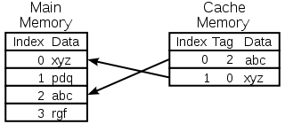
What is a cache
Cache is a hardware or software component that stores data so future requests for that data can be served faster; the data stored in a cache might be the result of an earlier computation, or the duplicate of data stored elsewhere.

Slide 3
Outline
General Revision of Cache
Cache in MIPS

Slide 4
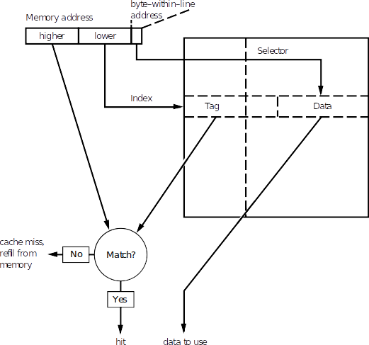
Cache (Direct-mapped)
Some terminologies:
  Cache line
  Cache tag
Advantage
  Simple
Disadvantage
  Lower bits conflict

Slide 5
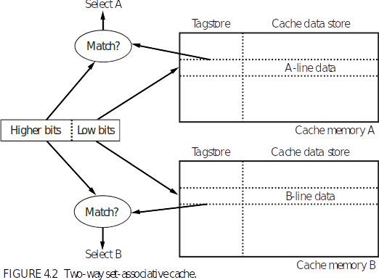
Compromise:
N-way associative cache
Notes:
A set-associative cache requires many more bus connections between the cache memory and controller. That means that caches too big to integrate onto a single chip are much easier to build direct mapped.
“least recently used” (“LRU”) line to be replaced, but maintaining strict LRU order means updating LRU bits in every cache line every time the cache is read. Moreover, keeping strict LRU information in a more-than-four-way set-associative cache
becomes impractical. Real caches often use compromise algorithms like “least recently filled” to pick the line to discard.

Slide 6
Write-through & Write-back
Write buffer (FIFO Q)
Terminologies:
  Modified | Dirty
A sub-variant:
  Write to Mem
  Write allocate
    IO problem!
Notes:
But CPU speeds have grown much faster than memory speeds, and some-
where around the time that the 32-bit MIPS generation was giving way to the
64-bit R4000, MIPS speeds passed the point where a memory system could
reasonably hope to absorb every write.

Slide 7
Other choices in Cache Design
Physical/Virtual address cache
  unique
Choice of line size
  Large cache bigger line
Split/unified
  L1 cache split into I- and D- cache
  L2, L3... caches are unified
Notes:
Virtual address cache is not unique, re-initialization needed after switch context.

Slide 8
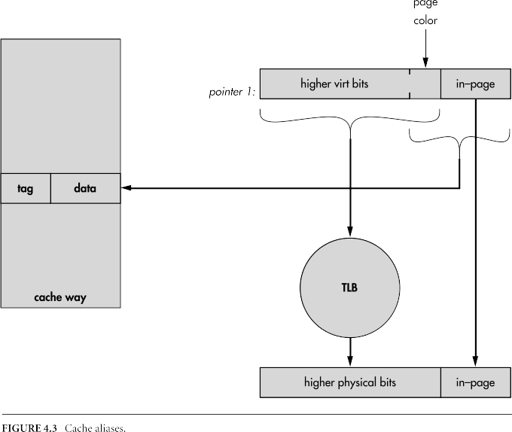
Cache alias
Index: 8KB
TLB page: 4KB
Program address
  0 0,0000,0000,0000
  4KB 1,0000,0000,0000

Slide 9
Cache alias
0
Index: 8KB
TLB page: 4KB
Program address
  0 0,0000,0000,0000
  4KB 1,0000,0000,0000
4K
4K
8K-1
0
8K-1

Slide 10
Cache Management
Terminologies:
  Coherent (hard-ware transparent) (snoopy)
    Snoop the shared address bus
    Other devices like CPU & DMA
MIPS
  Took the radical position
Notes:
龙芯3A2000 由硬件维护处理器、以及通过 HT 端口接入的 I/O 之间的 Cache 一致性,但硬件不维护通过PCI 接入到系统中的 I/O 设备的Cache 一致性。在驱动程序开发时,对通过PCI 接入的设备进行 DMA(Direct Memory Access)传输时,需要由软件进行 Cache 一致性
维护。

Slide 11
Cache Efficiency
Terminologies:
  Cache misses per instruction
  Cache miss/refill penalty
Why not cache miss rate? (miss per CPU memory access)
  X86 short of registers
  Use stack as surrogates for registers
Notes:
In many current systems (particularly embedded systems, where there’s a need to economize on cache sizes and memory performance) the CPU
is waiting for a cache refill for 50 percent to 65 percent of its time. At this point, doubling the performance of the CPU core will deliver only a 15 percent to 25 percent increase in application performance.

Slide 12
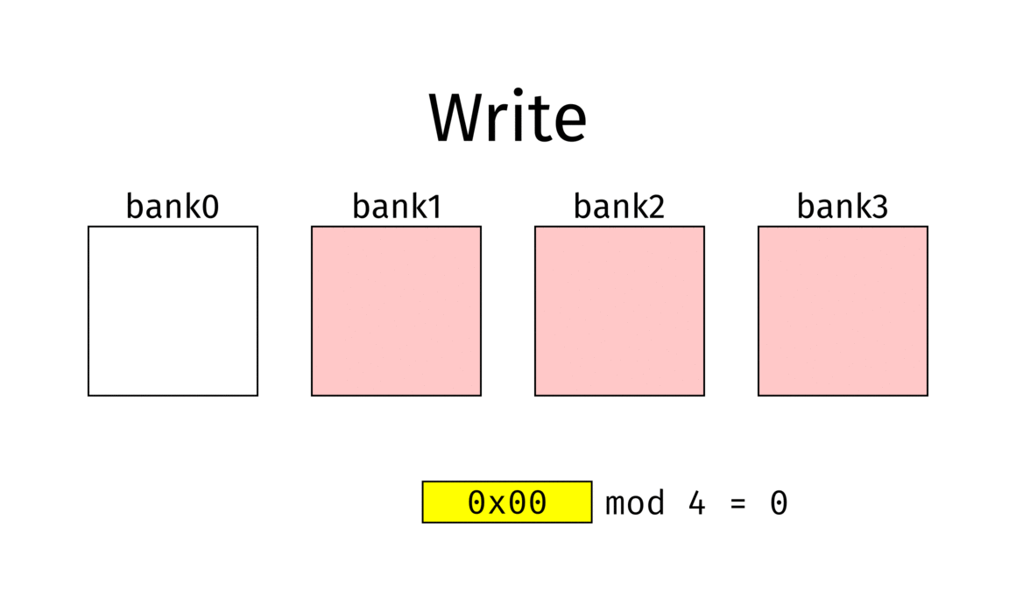
Cache Efficiency
Reduce misses
  Bigger cache
  Bigger set size
  Add cache level
  Reorganize software
Reduce penalty
  Less DRAM start-up time
  Larger memory burst bandwidth
Others
  Critical word first
  Non-blocking load
    Out-of-Order pipeline
  Multi-thread CPU
Notes:
Bigger cache
Always effective but expensive & large space
Associativity
Too small to notice
Add level
Reorganize
No general tool
Larger memory burst bandwidth
Bank interleaving

Slide 13
Software reorganization
First-time access, Replacement, Thrashing
Make it smaller
Make the heavily used portion of the program smaller
Force important content cached
Optimize code layout
Force rarely used not cached

Slide 14
MIPS32/64 Caches

Slide 15
Miscellaneous
To stage tag between cache an software: 32-bit TagLo and TagHi
Cache error handle
Cache configuration saved in CP0 Config1-2

Slide 16
The Cache Instructions
3 flavors:
  Hit-type cache operation
  Address-type cache operation
  Index-type cache operation
Must-supported instructions:
  Index invalidate
  Index store tag
  Hit write-back invalidate

Slide 17
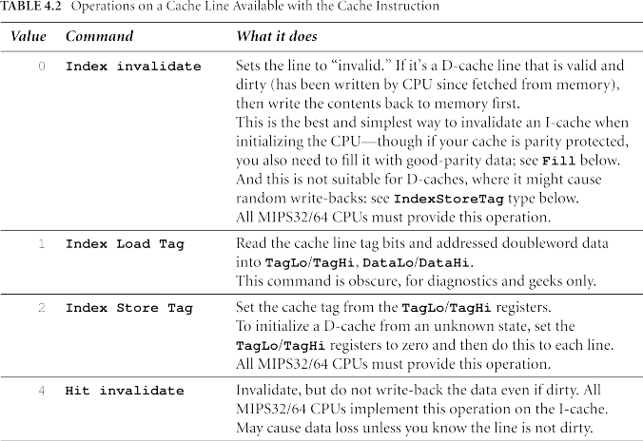
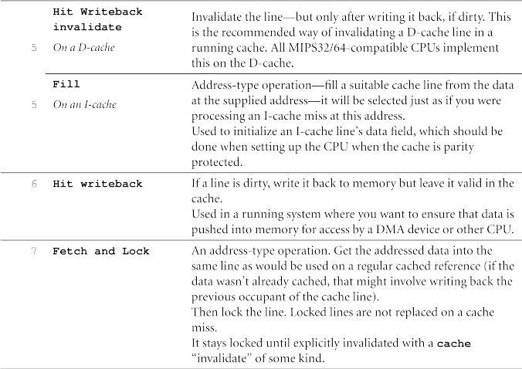
Cache instructions

Slide 18
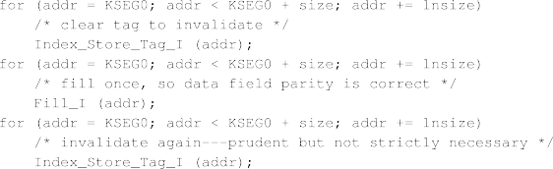
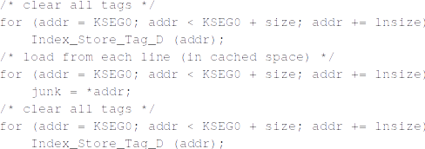
Initialize Routines: from bottom of System Memory

Slide 19
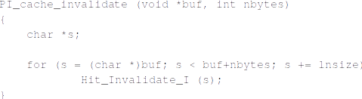
Invalidate & write back
Hit-style operation
If write back a huge area of memory, index operation is faster

Slide 20
Thanks!

